Slide 1
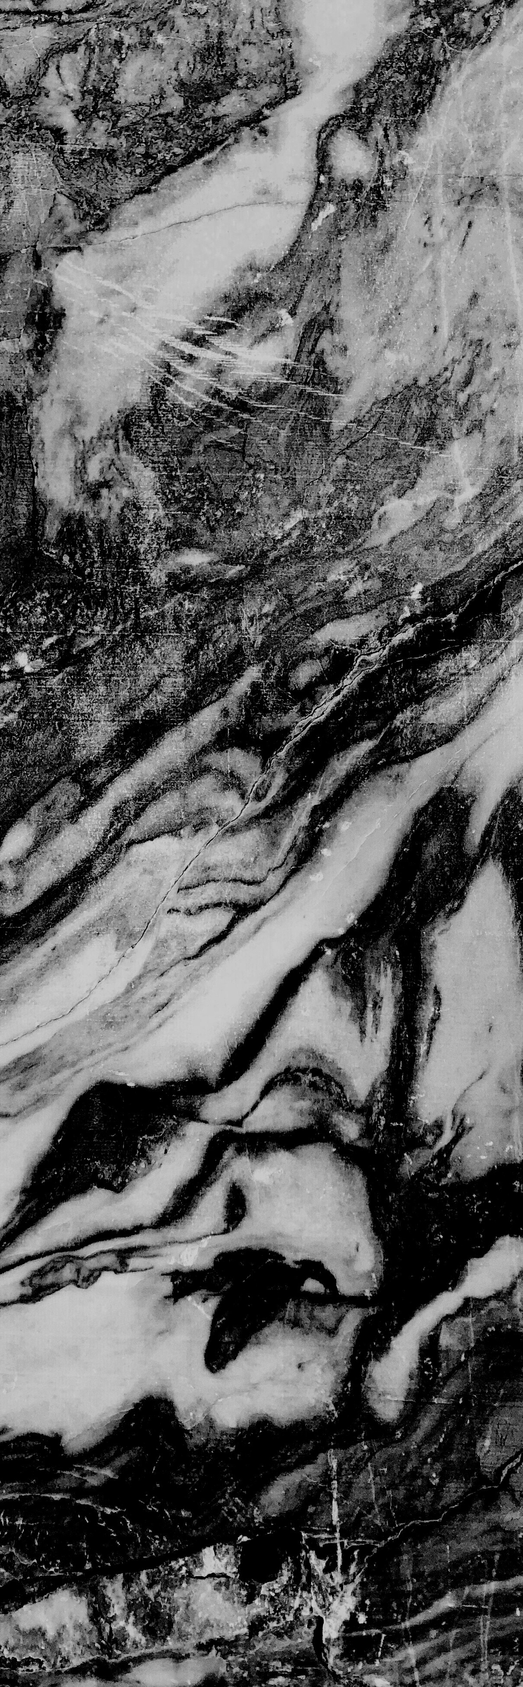
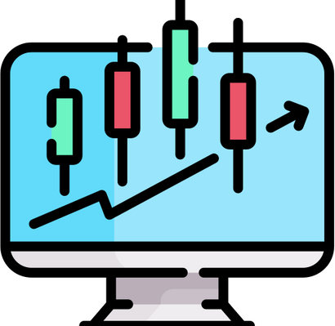
MonPrix
Presented by Team DieTorch

Slide 2




Our motivation
The stock market encourages good decisions in a company and enables growth.
Investing in stock market - risky and full of losses.
Lack of knowledge leads to beginners losing large amounts of money.
Our model provides insights to the user, educating them about profitable investments in the stock market.

Slide 3


Our Solution
Instead of cumbersome old methods, we offer simpler solutions.
We embrace learning by letting users compete against our AI Bot.
After the user provides input, we run a simulation to
show profitable strategies on this stock.
After learning, the user can practice on the same stock as the bot.

Slide 4
STOCK PREDICTION
Predicting stocks; make a profit of 40%
TRADING BOT
Embrace learning by letting users compete against our AI Bot.
GRAPHICAL INTERFACE
Interactive Learning with help of simulations such as graph
Features

Slide 5




How are we different?
No sign ups required ( we don't steal data)
You learn by looking at where an AI bot traded money only by going through the charts.
We encourage you to use your own judgement to trade instead of recommend tion.

Slide 6



Future Development
Portfolio management
Helps user manage his stocks.
Trading with Multi stocks
Trade bot can trade with multi stocks. Helps user make profits
Crypto price prediction
Predicting crypto currency prices for the next 5 days.

Slide 7
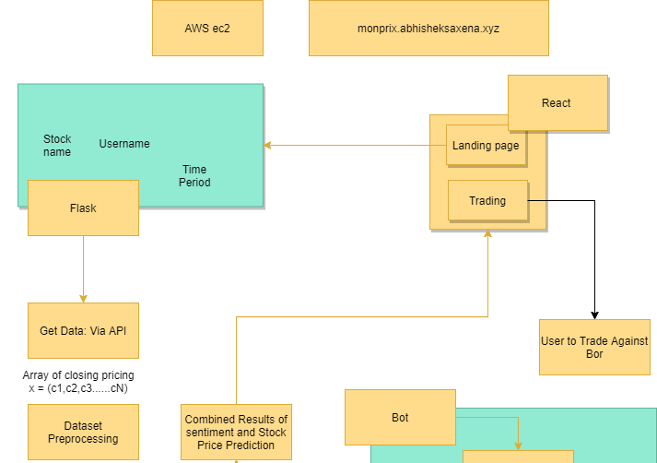

Slide 8
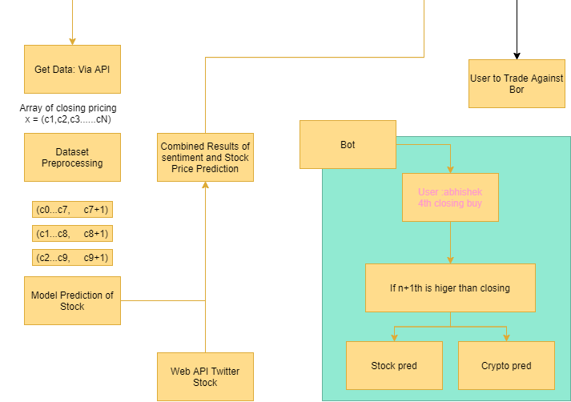

Slide 9

Thank You
Presented by Team DieTorch

